Slide 1
Counting by Mapping
A
B
…
f
…

Slide 2
Plan
We will study how to define mappings to count.
There will be many examples shown.
Bijection rule (this set of slides)
Division rule (next set of slides)
More mapping (next set of slides)

Slide 3
Counting Rule: Bijection
If f is a bijection from A to B,
then |A| = |B|
A
B
…
f
…
To compute |A|, one strategy is to define a bijection of A and B,
where B is easier to count and we can compute |B| directly.

Slide 4
Power Set
How many subsets of a set S?
P(S) = the power set of S
= the set of all subsets of S
for S = {a, b, c},
P(S) = {∅, {a}, {b}, {c}, {a,b}, {a,c}, {b,c}, {a,b,c} }
Suppose S has n elements.
How large is the power set of S?

Slide 5
Bijection: Power Set and Binary Strings
S : {s₁, s₂, s₃, s₄, s₅, … , s_{n}}
We define a bijection f between subsets and binary strings
A: the set of all subsets of S
B: the set of all n-bit strings
A
B
…
…
f
The mapping f :A->B is defined in the following way:
Given a subset T, we define f(T) as an n-bit string
with the i-th bit equal to 1 if and only if s_{i} is in T.

Slide 6
Bijection: Power Set and Binary Strings
S : {a,b,c}
P(S)
3-bit strings
∅,
{a},
{b},
{c},
{a,b},
{a,c},
{b,c},
{a,b,c}
000
001
010
011
100
101
110
111

Slide 7
Bijection: Power Set and Binary Strings
The mapping is defined in the following way:
subset: {s₁, s₃, s₄, … , s_{n}}
A
B
…
…
string: 1 0 1 1 0 … 1
f
This mapping is a bijection, because
two different subsets are mapped to two different strings (injection)
each binary string is mapped by some subset (surjection).
Therefore, |A| = |B|, and |B| can be computed directly.
So, |P(S)| = |n-bit binary strings| = 2^{n}.

Slide 8
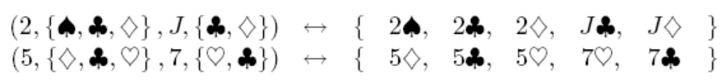
Bijection: Full House
We have used this idea before when we counted poker hands.
There is a bijection between Full Houses and sequences specifying:
1. The value of the triple, which can be chosen in 13 ways.
2. The suits of the triple, which can be selected in (4 3) ways.
3. The value of the pair, which can be chosen in 12 ways.
4. The suits of the pair, which can be selected in (4 2) ways.
A: the set of full houses
B: the set of sequences which satisfy (1)-(4).
A
B
…
…
f

Slide 9
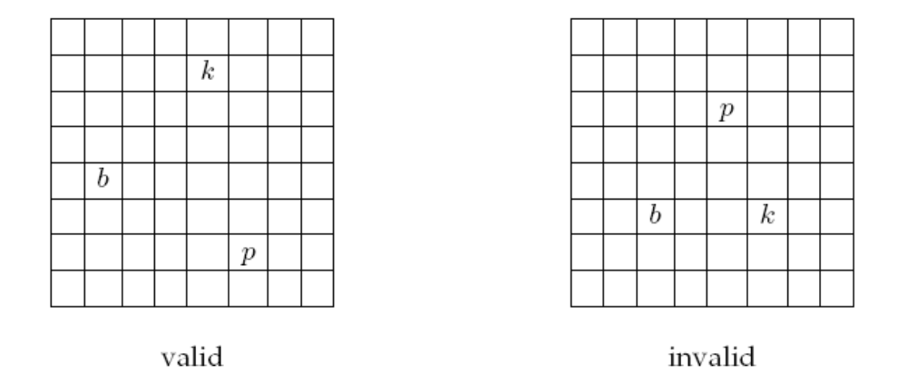
A Chess Problem
In how many different ways can we place a pawn (p),
a knight (k), and a bishop (b) on a chessboard so that
no two pieces share a row or a column?
Notes:
Mention poker hands

Slide 10
A Chess Problem
We define a mapping f between configurations to
sequences (r(p), c(p), r(k), c(k), r(b), c(b)),
where r(p), r(k), and r(b) are distinct rows,
and c(p), c(k), and c(b) are distinct columns.
A: the set of the configurations of the 3 pieces
B: the set of the such sequences of 6 numbers
A
B
…
…
f
If we can define a bijection between A and B,
and also calculate |B|, then we can determine |A|.

Slide 11
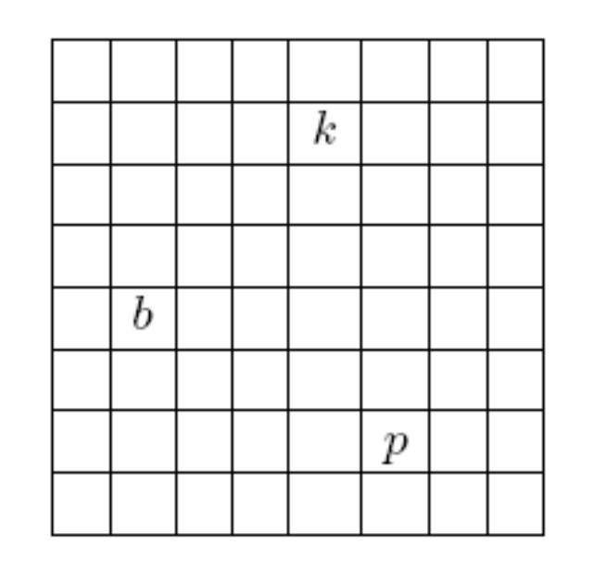
A Chess Problem
We define a mapping f between configurations to
sequences (r(p), c(p), r(k), c(k), r(b), c(b)),
where r(p), r(k), and r(b) are distinct rows,
and c(p), c(k), and c(b) are distinct columns.
f
(7,6,2,5,5,2)
This is a bijection, because:
no two configs map to same sequence (injection)
every such sequence is mapped (surjection)
(2,5)
(5,2)
So, to count the number of chess configurations,
it is equivalent to count the number of such sequences.
(7,6)

Slide 12
A Chess Problem
We define a mapping between configurations to
sequences (r(p), c(p), r(k), c(k), r(b), c(b)),
where r(p), r(k), and r(b) are distinct rows,
and c(p), c(k), and c(b) are distinct columns.
Using the generalized product rule,
there are 8 choices of r(p) and c(p),
there are 7 choices of r(k) and c(k),
there are 6 choices of r(b) and c(b).
Thus, total number of configurations
= (8x7x6)² = 112896.
(7,6,2,5,5,2)

Slide 13
Counting Rule: Bijection
If f is a bijection from A to B,
then |A| = |B|
Steps:
Come up with B.
Come up with f.
Show f is a bijection.
Compute |B|.
A
B
…
…
f
Usually the first two steps are more difficult.
Now we see some more interesting examples.

Slide 14

Counting Doughnut Selections
There are five kinds of doughnuts.
How many different ways to select a dozen doughnuts?
00 (none) 000000 00 00
Chocolate Lemon Sugar Glazed Plain
A ::= all selections of a dozen doughnuts
Hint: define a bijection to some bit strings!

Slide 15
Counting Doughnut Selections
A ::= all selections of a dozen doughnuts
B::= all 16-bit binary strings with exactly four 1’s.
Define a bijection f between A and B.
0011000000100100
00 1 1 000000 1 00 1 00
00 (none) 000000 00 00
Chocolate Lemon Sugar Glazed Plain
Each doughnut is represented by a 0,
and four 1’s are used to separate five types of doughnuts.

Slide 16
Counting Doughnut Selections
A ::= doughnuts selections
B::= all 16-bit strings with four 1’s.
12 0 0 0 0
Chocolate Lemon Sugar Glazed Plain
0000000000001111
2 3 0 3 4
Chocolate Lemon Sugar Glazed Plain
0010001100010000
2 0 6 2 2
Chocolate Lemon Sugar Glazed Plain
0011000000100100
0 0 0 0 12
Chocolate Lemon Sugar Glazed Plain
1111000000000000

Slide 17
Counting Doughnut Selections
c chocolate, l lemon, s sugar, g glazed, p plain maps to
0^{c}10^{l}10^{s}10^{g}10^{p}
A ::= all selections of a dozen doughnuts
B::= all 16-bit binary strings with exactly four 1’s.
This is a bijection because
Two doughnut selections map to two different strings. (injection)
(think of a doughnut selection as a sequence of 5 numbers (c,l,s,g,p),
consider the first number which is different in the two sequences).
Every string in B corresponds to a valid doughnut selection. (surjection)

Slide 18
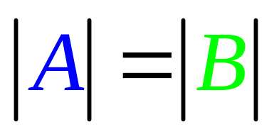
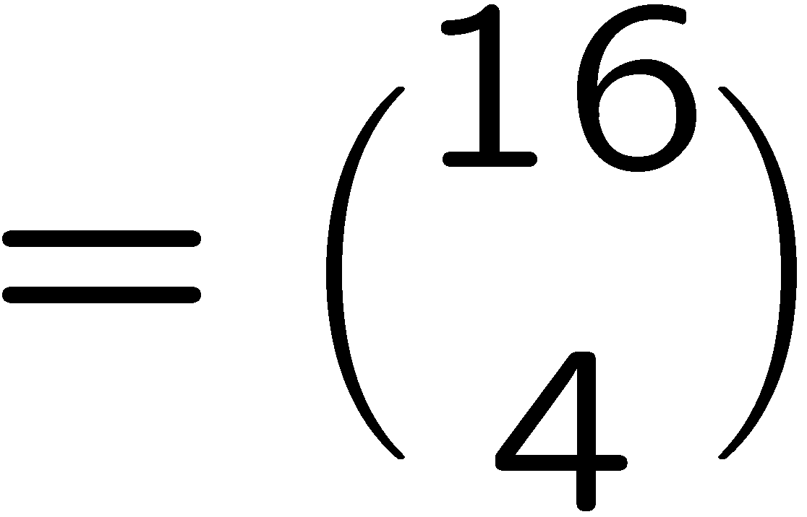
Counting Doughnut Selections
c chocolate, l lemon, s sugar, g glazed, p plain maps to
0^{c}10^{l}10^{s}10^{g}10^{p}
A ::= all selections of a dozen doughnuts
B::= all 16-bit binary strings with exactly four 1’s.

Slide 19
Counting Loops
for i=1 to n do
for j=1 to i do
for k=1 to j do
printf(“hello world\n”);
How many “hello world” will this program print?
A ::= all (i,j,k) triple
B::= all strings with n-1 zeroes and 3 ones.

Slide 20
Counting Loops
for i=1 to n do
for j=1 to i do
for k=1 to j do
printf(“hello world\n”);
There are n possible values for the i,j,k.
1 2 3 4 5 … n
…
Imagine there are n-1 separators for the n values.
If i=4, j=2, k=2, then there are two zeroes in 2 and one zero in 4.

Slide 21
Counting Loops
for i=1 to n do
for j=1 to i do
for k=1 to j do
printf(“hello world\n”);
There are n possible values for the i,j,k.
1 2 3 4 5 … n
…
k
j
i
In general, the position of the first zero corresponds to the value of k.
The position of the second zero corresponds to the value of j.
The position of the third zero corresponds to the value of i.

Slide 22
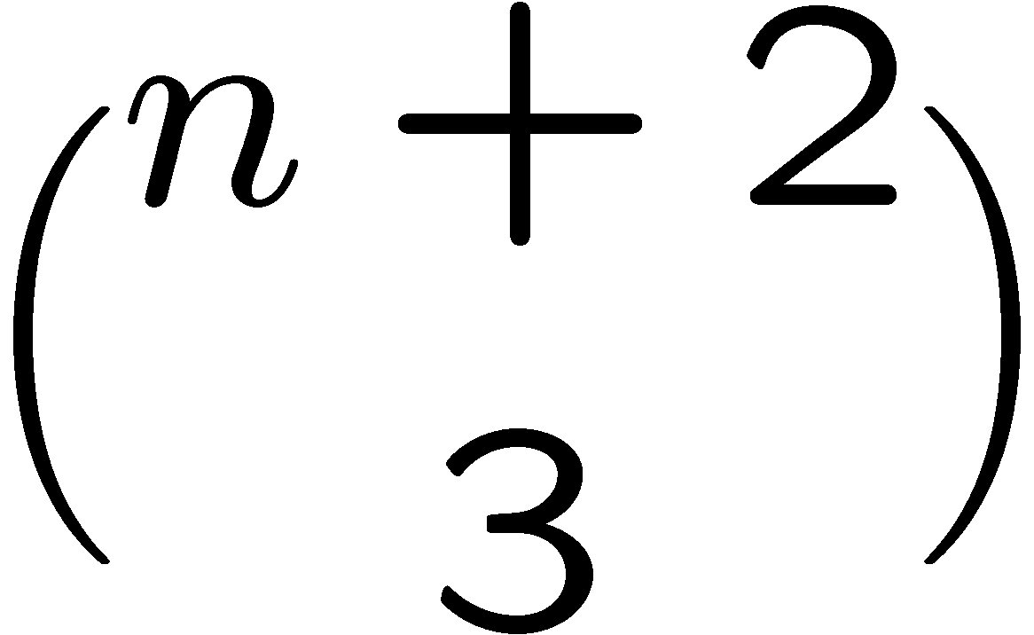
Counting Loops
for i=1 to n do
for j=1 to i do
for k=1 to j do
printf(“hello world\n”);
There are n possible values for the i,j,k.
1 2 3 4 5 … n
…
This is a bijection (verify this!) between the values for i,j,k
and the set of strings with n-1 ones and 3 zeros.
So, the program prints “hello world” exactly times.

Slide 23
Counting Non-Negative Integer Solutions
How many solutions are there to the equation x₁+x₂+x₃+x₄=10,
where x₁,x₂,x₃,x₄ are nonnegative integers?
It is just like buying 10 doughnuts from 4 types.
A ::= all non-negative integer solutions x₁+x₂+x₃+x₄=10
B::= all 13-bit binary strings with exactly three 1’s.
Think of there are 10 points to be distributed into 4 variables.
x₁ x₂ x₃ x₄
e.g. Suppose x₁=3, x₂=5, x₃=2, x₄=0,
the 3 ones are used for separations.
0 0 0 0 0 0 0 0 0 0

Slide 24
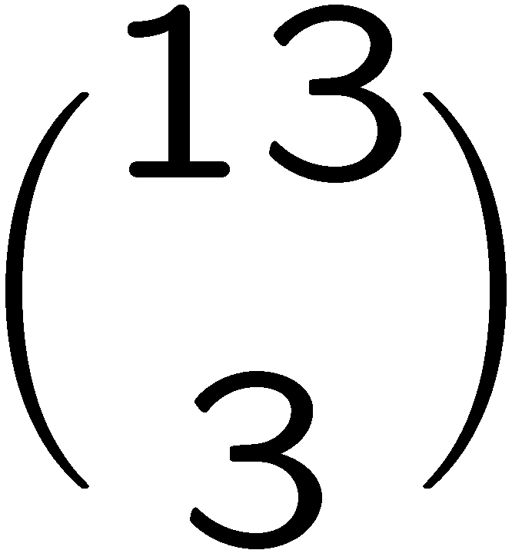
Counting Non-Negative Integer Solutions
How many solutions are there to the equation x₁+x₂+x₃+x₄=10,
where x₁,x₂,x₃,x₄ are nonnegative integers?
It is just like buying 10 doughnuts from 4 types.
A ::= all non-negative integer solutions x₁+x₂+x₃+x₄=10
B::= all 13-bit binary strings with exactly three 1’s.
It is not difficult to verify that this is a bijection,
by the same argument as in doughnut selections.
So, the are exactly integer solutions.

Slide 25
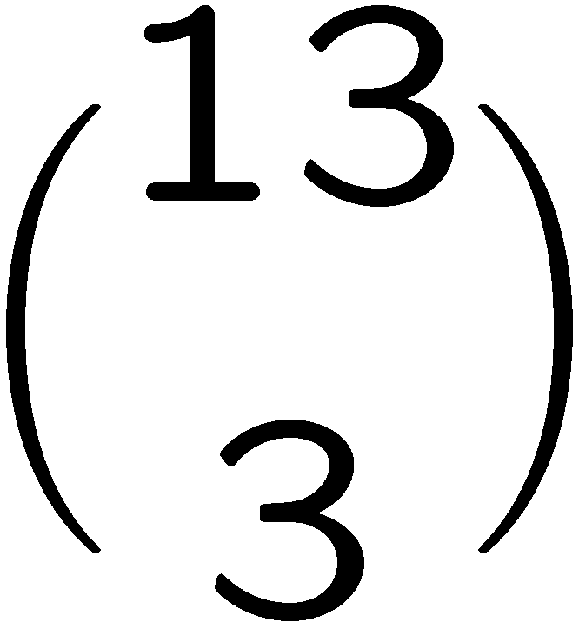
Counting Positive Integer Solutions
How many integer solutions to x₁+x₂+x₃+x₄=14 if each x_{i}>=1?
Set x_{i}=y_{i}+1.
Consider the equation y₁+y₂+y₃+y₄=10 where each y_{i} >=0.
There is a bijection between the solutions for y and
the solutions for x.
Therefore we can apply the previous result,
and conclude that the answer is

Slide 26
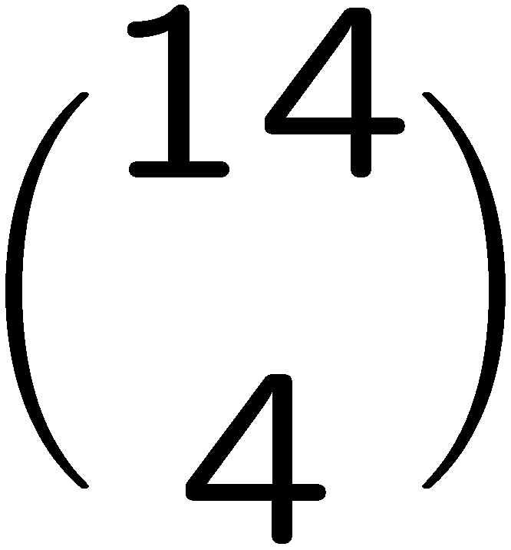
Counting Positive Integer Solutions
How many integer solutions to x₁+x₂+x₃+x₄<=10 if each x_{i}>=0?
Consider the equation y₁+y₂+y₃+y₄+y₅=10 where each y_{i}>=0.
There is a bijection between the solutions for y and
the solutions for x.
Therefore we can apply the previous result,
and conclude that the answer is
because we need 4 ones and 10 zeroes.

Slide 27
Choosing Non-Adjacent Books
There are 20 books arranged in a row on a shelf.
How many ways to choose 6 of these books so that
no two adjacent books are selected?
A ::= all selections of 6 non-adjacent books from 20 books
B::= all 15-bit binary strings with exactly six 1’s.

Slide 28
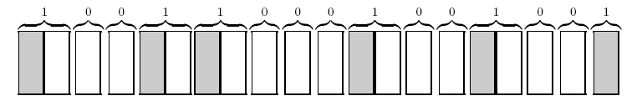
Choosing Non-Adjacent Books
A ::= all selections of 6 non-adjacent books from 20 books
B::= all 15-bit binary strings with exactly six 1’s.
Map each zero to a non-chosen book, each of the first five 1’s to a chosen
book followed by a non-chosen book, and the last 1 to a chosen book.
This is a bijection, because:
Two different selections are mapped to two different strings (injection)
(consider the first position that is different in the two selections)
Every string in B corresponds to a valid selection (surjection)

Slide 29
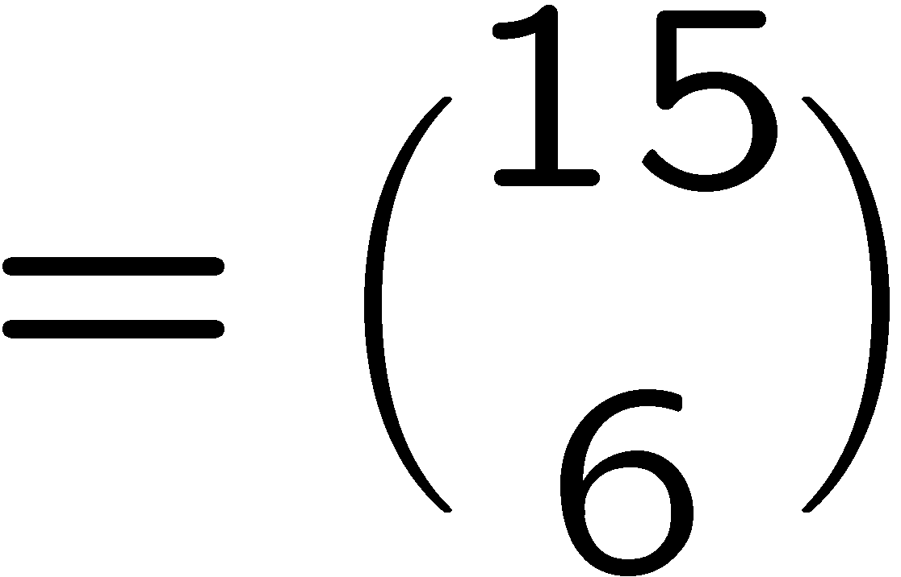
Choosing Non-Adjacent Books
A ::= all selections of 6 non-adjacent books from 20 books
B::= all 15-bit binary strings with exactly six 1’s.

Slide 30
Choosing Non-Adjacent Books
A ::= all selections of 6 non-adjacent books from 20 books
B::= the set of integer solutions to x₁+x₂+x₃+x₄+x₅+x₆<=20
where x₁>=1 and x₂,x₃,x₄,x₅,x₆>=2.
Here, each x_{i} represents to pick the x_{i} book after the previous chosen book.
e.g. this configuration corresponds to x₁=1, x₂=4, x₃=2, x₄=5, x₅=4, x₆=4.
It is not difficult to check that this is a bijection.

Slide 31
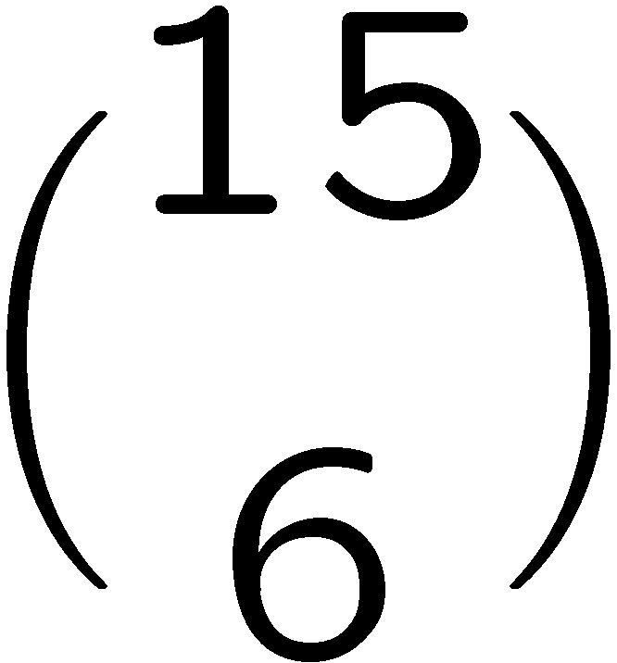
Choosing Non-Adjacent Books
A ::= all selections of 6 non-adjacent books from 20 books
B::= the set of integer solutions to x₁+x₂+x₃+x₄+x₅+x₆<=20
where x₁>=1 and x₂,x₃,x₄,x₅,x₆>=2.
From slide 24 we learned that |B|=|C| for
C::= the set of integer solutions to x₁+x₂+x₃+x₄+x₅+x₆<=9
where x₁,x₂,x₃,x₄,x₅,x₆>=0.
From slide 26 we learned that |C|=|D| for
D::= the set of integer solutions to x₁+x₂+x₃+x₄+x₅+x₆+x₇=9
where x₁,x₂,x₃,x₄,x₅,x₆,x₇>=0.
From slide 24 we learned that |D|=

Slide 32
Exercises
What is the number of non-negative integer solutions to x₁+x₂+…+x_{m}=n?
What is the number of integer solutions to x₁+x₂+…+x_{m}=n
where x₁>=a₁, x₂>=a₂, …, and x_{m}>=a_{m}?
What is the number of integer solutions to x₁+x₂+…+x_{m}<n
where x₁>=a₁, x₂>=a₂, …, and x_{m}>=a_{m}?

Slide 33
Exercises
How many “hello world” will this program print?
for i=1 to n do
for j=1 to i-1 do
for k=1 to j-1 do
printf(“hello world\n”);
What is the number of non-negative integer solutions to x₁+x₂=n
where x₁<a₁ and x₂<a₂? (Tricky, go to tutorial!)
(Hint 1: count the complement.)
(Hint 2: inclusion-exclusion.)

